Slide 1
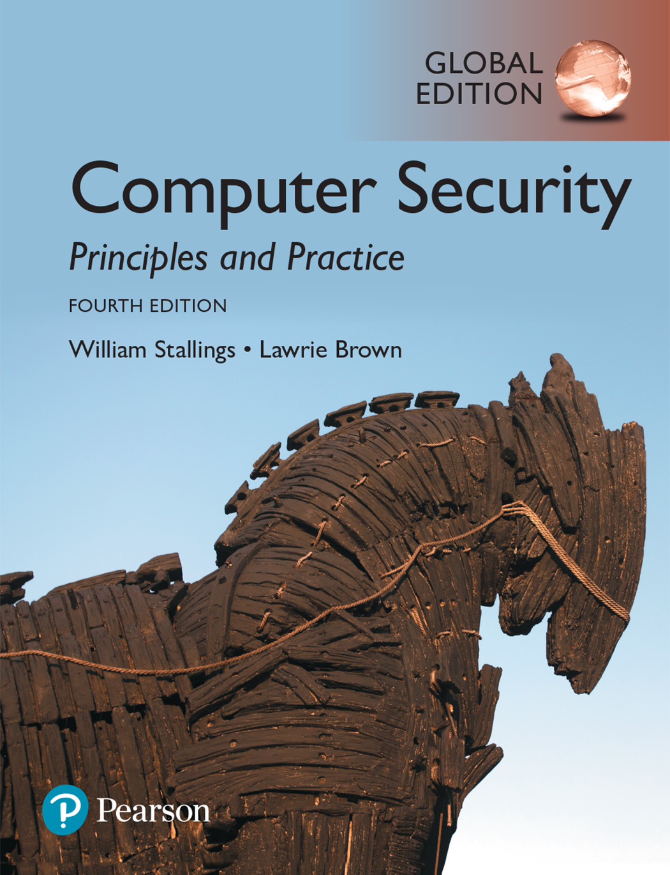

Slide 2
Chapter 5
Malicious Software and Attacks

Slide 3
Malicious software, or malware
Malicious software, or malware, arguably constitutes one of the most significant categories of threats to computer systems.
Malware can be defined as
“A program that is inserted into a system, usually covertly, with the intent of compromising the confidentiality, integrity, or availability of the victim’s data, applications, or operating system or otherwise annoying or disrupting the victim.”

Slide 4
Types of Malicious Software (Malware)
Name | Description
Advanced Persistent Threat (APT) | Cybercrime directed at business and political targets, using a wide variety of intrusion technologies and malware, applied persistently and effectively to specific targets over an extended period, often attributed to state-sponsored organizations.
Adware | Advertising that is integrated into software. It can result in pop-up ads or redirection of a browser to a commercial site.
Attack kit | Set of tools for generating new malware automatically using a variety of supplied propagation and payload mechanisms.
Auto-rooter | Malicious hacker tools used to break into new machines remotely.
Backdoor (trapdoor) | Any mechanism that bypasses a normal security check; it may allow unauthorized access to functionality in a program, or onto a compromised system.
Downloaders | Code that installs other items on a machine that is under attack. It is normally included in the malware code first inserted on to a compromised system to then import a larger malware package.

Slide 5
Types of Malicious Software (Malware)
Name | Description
Flooders (DoS client) | Used to generate a large volume of data to attack networked computer systems, by carrying out some form of denial-of-service (DoS) attack.
Keyloggers | Captures keystrokes on a compromised system.
Logic bomb | Code inserted into malware by an intruder. A logic bomb lies dormant until a predefined condition is met; the code then triggers an unauthorized act.
Macro virus | A type of virus that uses macro or scripting code, typically embedded in a document, and triggered when the document is viewed or edited, to run and replicate itself into other such documents.
Rootkit | Set of hacker tools used after attacker has broken into a computer system and gained root-level access.
Spammer programs | Used to send large volumes of unwanted e-mail.

Slide 6
Types of Malicious Software (Malware)
Name | Description
Spyware | Software that collects information from a computer and transmits it to another system by monitoring keystrokes, screen data, and/or network traffic; or by scanning files on the system for sensitive information.
Trojan horse | A computer program that appears to have a useful function, but also has a hidden and potentially malicious function that evades security mechanisms, sometimes by exploiting legitimate authorizations of a system entity that invokes it.
Virus | Malware that, when executed, tries to replicate itself into other executable machine or script code; when it succeeds, the code is said to be infected. When the infected code is executed, the virus also executes.
Worm | A computer program that can run independently and can propagate a complete working version of itself onto other hosts on a network, by exploiting software vulnerabilities in the target system, , or using captured authorization credentials.
Zombie, bot | Program installed on an infected machine that is activated to launch attacks on other machines.

Slide 7
The Nature of Viruses
A computer virus is a piece of software that can “infect” other programs, or indeed any type of executable content, by modifying them. The modification includes injecting the original code with a routine to make copies of the virus code, which can then go on to infect other content.

Slide 8
Components of Computer Virus
A computer virus has three parts. More generally, many contemporary types of malware also include one or more variants of each of these components:
Infection mechanism: The means by which a virus spreads or propagates, enabling it to replicate. The mechanism is also referred to as the infection vector.
Trigger: The event or condition that determines when the payload is activated or delivered, sometimes known as a logic bomb.
Payload: What the virus does, besides spreading. The payload may involve damage or may involve benign but noticeable activity.

Slide 9
Components of Computer Virus
Infection mechanism
The means by which a virus spreads or propagates, enabling it to replicate
Also referred to as the infection vector
Trigger
The event or condition that determines when the payload is activated or delivered
Sometimes known as a logic bomb
Payload
What the virus does, besides spreading
May involve damage or benign but noticeable activity

Slide 10
Phases of Computer Virus lifetime
During its lifetime, a typical virus goes through the following four phases:
Dormant phase: The virus is idle. The virus will eventually be activated by some event, such as a date, the presence of another program or file, or the capacity of the disk exceeding some limit. Not all viruses have this stage.
Propagation phase: The virus places a copy of itself into other programs or into certain system areas on the disk.
Triggering phase: The virus is activated to perform the function for which it was intended.
Execution phase: The function is performed. The function may be harmless, such as a message on the screen, or damaging, such as the destruction of programs and data files.

Slide 11
Phases of Computer Virus lifetime
Dormant phase
Triggering phase
Propagation phase
Execution phase
Virus is idle
Will eventually be activated by some event
Not all viruses have this stage
Virus is activated to perform the function for which it was intended
Can be caused by a variety of system events
Virus places a copy of itself into other programs or into certain system areas on the disk
May not be identical to the propagating version
Each infected program will now contain a clone of the virus which will itself enter a propagation phase
Function is performed
May be harmless or damaging

Slide 12
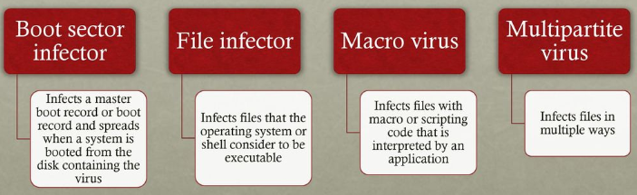
Virus Classification (based on target)
A virus classification by target includes the following categories:
Boot sector infector: Infects a master boot record or boot record and spreads when a system is booted from the disk containing the virus.
File infector: Infects files that the operating system or shell consider to be executable.
Macro virus: Infects files with macro or scripting code that is interpreted by an application.
Multipartite virus: Infects files in multiple ways. Typically, the multipartite virus is capable of infecting multiple types of files, so that virus eradication must deal with all of the possible sites of infection.

Slide 13
Viruses Classification (based on concealment strategy)
A virus classification by concealment strategy includes the following categories:
Encrypted virus: A form of virus that uses encryption to obscure it’s content. A portion of the virus creates a random encryption key and encrypts the remainder of the virus. The key is stored with the virus. When an infected program is invoked, the virus uses the stored random key to decrypt the virus.
Stealth virus: A form of virus explicitly designed to hide itself from detection by anti-virus software. Thus, the entire virus, not just a payload is hidden. It may use code mutation, compression, or rootkit techniques to achieve this.

Slide 14
Viruses Classification (based on concealment strategy)
Polymorphic virus: A form of virus that creates copies during replication that are functionally equivalent but have distinctly different bit patterns, in order to defeat programs that scan for viruses. In this case, the “signature” of the virus will vary with each copy.
Metamorphic virus: As with a polymorphic virus, a metamorphic virus mutates with every infection. The difference is that a metamorphic virus rewrites Itself completely at each iteration, using multiple transformation techniques, increasing the difficulty of detection. Metamorphic viruses may change their behavior as well as their appearance.

Slide 15
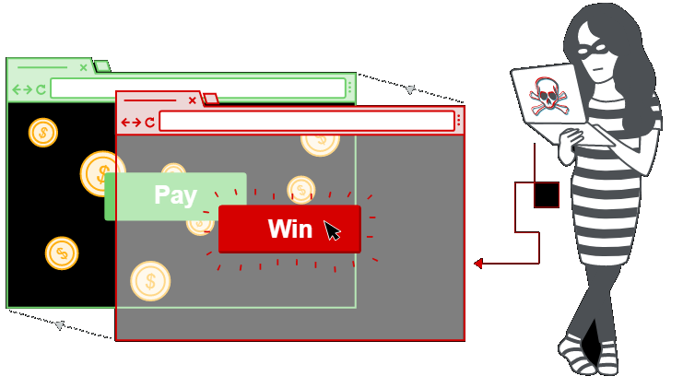
Clickjacking
Clickjacking, also known as a user-interface (UI) redress attack, is a vulnerability used by an attacker to collect an infected user’s clicks. The attacker can force the user to do a variety of things from adjusting the user’s computer settings to unwittingly sending the user to Web sites that might have malicious code.
Also, by taking advantage of Adobe Flash or JavaScript, an attacker could even place a button under or over a legitimate button, making it difficult for users to detect.

Slide 16

Bot and Botnet
The Bot malware subverts the computational and network resources of the infected system for use by the attacker. Such a system is known as a bot (robot), zombie or drone, and secretly takes over another Internet-attached computer and then uses that computer to launch or manage attacks that are difficult to trace to the bot’s creator.
The collection of bots often is capable of acting in a coordinated manner; such a collection is referred to as a botnet. This type of payload attacks the integrity and availability of the infected system.

Slide 17

Phishing and Identity Theft
An approach used to capture a user’s login and password credentials is to include a URL in a spam e-mail that links to a fake Web site controlled by the attacker, but which mimics the login page of some banking, gaming, or similar site.
This is normally included in some message suggesting that urgent action is required by the user to authenticate their account, to prevent it being locked.
This is known as a phishing attack and exploits social engineering to leverage user’s trust by masquerading as communications from a trusted source

Slide 18
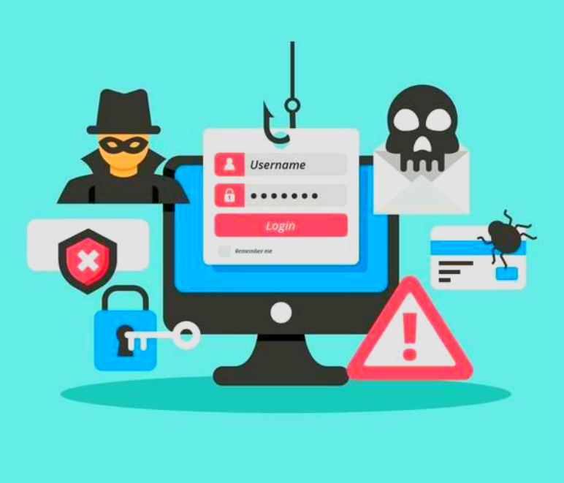
Spear-phishing
A more dangerous variant of phishing is the spear-phishing attack. This again is an e-mail claiming to be from a trusted source. However, the recipients are carefully researched by the attacker, and each e-mail is carefully crafted to suit its recipient specifically, often quoting a range of information to convince them of its authenticity.
This greatly increases the likelihood
of the recipient responding as
desired by the attacker.

Slide 19
Malware Countermeasure Approaches
Prevention Approach
The ideal solution to the threat of malware is prevention: Do not allow malware to get into the system in the first place, or block the ability of it to modify the system. This goal is, in general, nearly impossible to achieve, although taking suitable countermeasures to harden systems and users in preventing infection can significantly reduce the number of successful malware attacks. .
Updating: One of the first countermeasures that should be employed is to ensure all systems are as current as possible, with all patches applied, in order to reduce the number of vulnerabilities that might be exploited on the system.
Access Control: The next is to set appropriate access controls on the applications and data stored on the system, to reduce the number of files that any user can access, and hence potentially infect or corrupt, as a result of them executing some malware code.
User Awareness: The third common propagation mechanism, which targets users in a social engineering attack, can be countered using appropriate user awareness and training.

Slide 20
Malware Countermeasure Approaches
If prevention fails, then technical mechanisms can be used to support the following threat mitigation options:
Detection: Once the infection has occurred, determine that it has occurred and locate the malware.
Identification: Once detection has been achieved, identify the specific malware that has infected the system.
Removal: Once the specific malware has been identified, remove all traces of malware virus from all infected systems so that it cannot spread further.

Slide 21
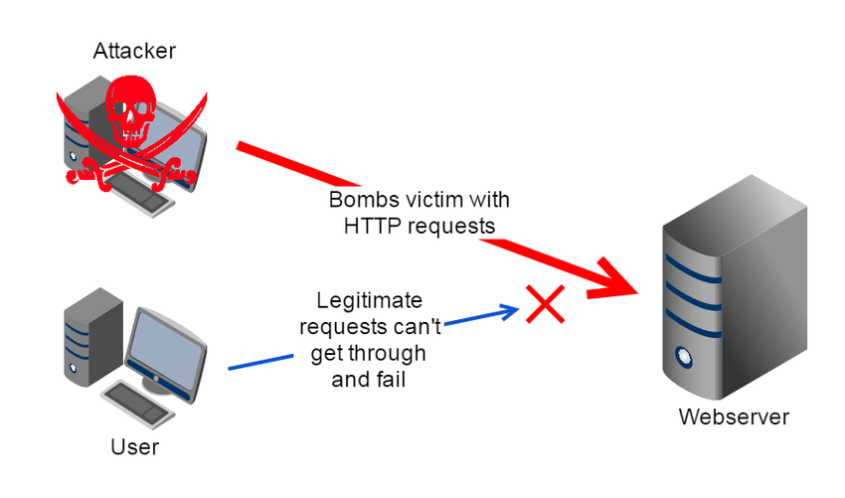
Denial-of-Service (DoS) attack
“A denial of service (DoS) is an action that prevents or impairs the authorized use of networks, systems, or applications by exhausting resources such as central processing units (CPU), memory, bandwidth, and disk space.”

Slide 22
Forms of DoS attack
A form of attack on the availability of some service
Categories of resources that could be attacked are:
Network bandwidth
Relates to the capacity of the network links connecting a server to the Internet
For most organizations this is their connection to their Internet Service Provider (ISP)
System resources
Aims to overload or crash the network handling software
Application resources
Typically involves a number of valid requests, each of which consumes significant resources, thus limiting the ability of the server to respond to requests from other users

Slide 23
Poison packet attack
Another form of system resource attack uses packets whose structure triggers a bug in the system’s network handling software, causing it to crash. This means the system can no longer communicate over the network until this software is reloaded, generally by rebooting the target system. This is known as a poison packet.

Slide 24
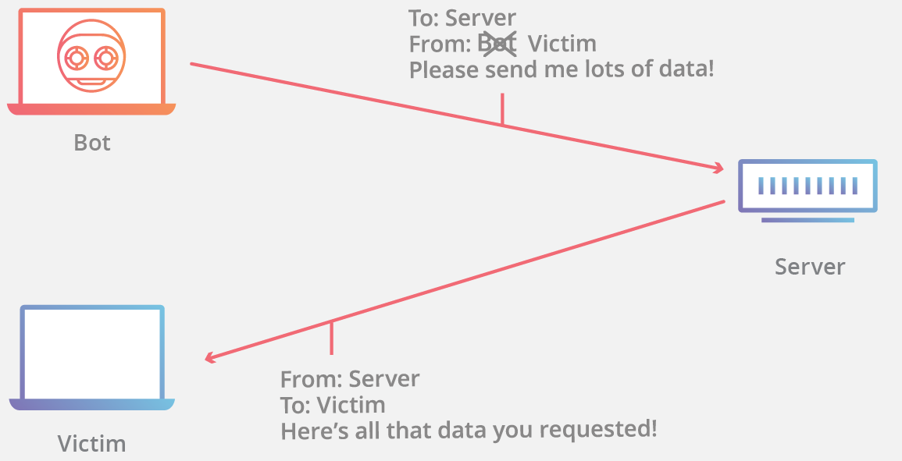
Source Address Spoofing
A common characteristic of packets used in many types of DoS attacks is the use of forged source addresses. This is known as source address spoofing. Given sufficiently privileged access to the network handling code on a computer system, it is easy to create packets with a forged source address (and indeed any other attribute that is desired).

Slide 25
Distributed Denial of Service (DDoS) Attacks
Use of multiple systems to generate attacks
Attacker uses a flaw in operating system or in a common application to gain access and installs their program on it (zombie)
Large collections of such systems under the control of one attacker’s control can be created, forming a botnet

Slide 26
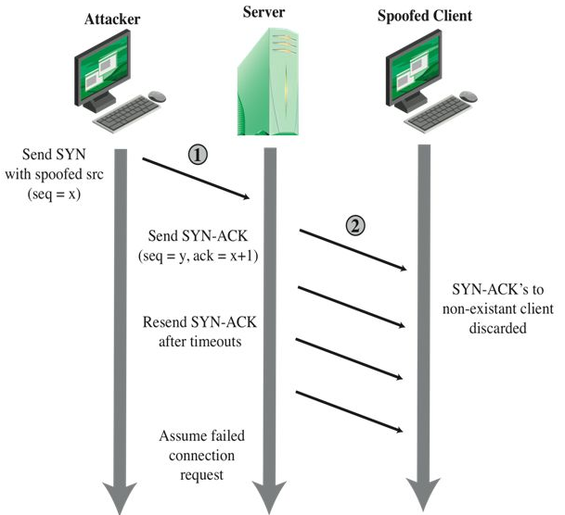
Syn Spoofing
A SYN spoofing attack exploits this behavior on the targeted server system. The attacker generates a number of SYN connection request packets with forged source addresses. For each of these, the server records the details of the TCP connection request and sends the SYN-ACK packet to the claimed source address.

Slide 27
Defenses against denial-of-service Attacks
There are a number of steps that can be taken both to limit the consequences of being the target of a DoS attack and to limit the chance of your systems being compromised and then used to launch DoS attacks.
In a distributed denial-of-service attack (DDoS attack), the incoming traffic flooding the victim originates from many different sources. This effectively makes it impossible to stop the attack simply by blocking a single source.
The defense against DoS and DDoS attacks have been discussed in next slide.

Slide 28
Defense against DoS or DDoS attacks
In general, there are four lines of defense against DoS or DDoS attacks:
Attack prevention and preemption (before the attack): These mechanisms enable the victim to endure attack attempts without denying service to legitimate clients.
Attack detection and filtering (during the attack): These mechanisms attempt to detect the attack as it begins and respond immediately. This minimizes the impact of the attack on the target.
Attack source traceback and identification (during and after the attack): This is an attempt to identify the source of the attack as a first step in preventing future attacks.
Attack reaction (after the attack): This is an attempt to eliminate or curtail the effects of an attack.

Slide 29
Thank You!

